Slide 1

Domain: Python
Technology: Deep Learning
FACE RECOGNITION BASED ATTENDANCE SYSTEM USING DEEP LEARNING

Slide 2
INDEX
Abstract
Introduction
Literature review
Existing Method
Drawbacks
Advantages
Implementation
Proposed method
Hardware and Software Requirements
Architecture
System Design
Results
Conclusion
References

Slide 3
ABSTRACT
This paper is about the biometric attendance management. The automatic attendance management will replace the manual method, which takes a lot of time consuming and difficult to maintain. There are many biometric processes, in that face recognition is the best method. Here we are using the Deep Learning (DL) based Convolutional Neural Network (CNN) algorithm. We are considering the human faces as a dataset that which were train using CNN. For user interface webpage created using flask framework
Keywords: Attendance Management, Computer Vision, Deep Learning, Human Face Images.

Slide 4
INTRODUCTION
Biometrics are body measurements and calculations related to human characteristics. Biometrics authentication (or realistic authentication) is used in computer science as a form of identification and access control. It is also used to identify individuals in groups that are under surveillance.
Biometric identifiers are the distinctive, measurable characteristics used to label and describe individuals. Biometric identifiers are often categorized as physiological characteristics, which are related to the shape of the body.
Examples include, but are not limited to fingerprint, palm veins, face recognition, DNA, palm print, hand geometry, iris recognition, retina and odor/scent. Behavioral characteristics are related to the pattern of behavior of a person, including but not limited to typing rhythm, gait, keystroke, signature, behavioral profiling, and voice. Some researchers have coined the term 'behaviometrics' to describe the latter class of biometrics.

Slide 5
INTRODUCTION
Many different aspects of human physiology, chemistry or behavior can be used for biometric authentication. The selection of a particular biometric for use in a specific application involves a weighting of several factors. Jain et al. (1999) identified seven such factors to be used when assessing the suitability of any trait for use in biometric authentication.
• Universality means that every person using a system should possess the trait.
• Uniqueness means the trait should be sufficiently different for individuals in the relevant population such that they can be distinguished from one another.

Slide 6
Permanence relates to the manner in which a trait varies over time. More specifically, a trait with 'good' permanence will be reasonably invariant over time with respect to the specific matching algorithm.
• Measurability (collectability) relates to the ease of acquisition or measurement of the trait. In addition, acquired data should be in a form that permits subsequent processing and extraction of the relevant feature sets.
• Performance relates to the accuracy, speed, and robustness of technology used (see performance section for more details).

Slide 7
LITERATURE REVIEW
S. No | Journal Type with year | Authors | Title | Outcomes
1 | International Journal of Computer Science Issue, Vol.9, Issue 4, No 1, July 2012. | Naveed Khan Balcoh, M. HaroonYousaf, Waqar Ahma and M. Iram Baig | Algorithm for efficient Attendance Management | Attendance Management Algorithm
2 | International Journal of Computer and Communication Engineering, Vol 1, No 2,July 2012 | NirmalayaKar, MrinalKanti Debbarma, Ashim Saha, and Dwijen RudraPal | Study of implementing Automated Attendance System using Implementing Automated Attendance System Using face recognition Technique | Automated Attendance System Using face recognition Technique

Slide 8
LITERATURE REVIEW:
S. No | Journal Type with year | Authors | Title | Outcomes
3 | The Pacific Journal of Science and Technology Volume 13, No 1, May 2012 | O. Shoewn | Development of Attendance Management System using Biometrics | Attendance Management System using Biometrics
4 | vol. 35, No 4, Dec 2003, pp.399-458 | M. Turk and A. Pentland | Face Recognition: A Literature Survey | A Literature Survey on Face Recognition

Slide 9
LITERATURE REVIEW
S. No | Journal Type with year | Authors | Title | Outcomes
3 | Volume 1, Issue 11, July-2014 | Rekha A. L, Chethan H. K | Automated Attendance System Management System Using Face Recognition through Video Surveillance | Video surveillance is used to detect the object movement thereby the captured image undergoes face detection and recognition process.
4 | 2020 International conference paer | Jomon Joseph1, K. P. Zacharia | Face Recognition Based Smart Attendance System | here raspberry pi, OpenCV and Dlib are used for recognizing face

Slide 10
EXISTING METHOD
In existing system biometric system is usually used in any organisation which takes a lot of time and it also requires finger print of a person to take the attendance. Sometimes which will be failed in detecting the finger print that which could cause problem in taking attendance.

Slide 11
DISADVANTAGES IN EXISTING METHOD
Time taking.
Sometimes failed in detecting the finger print.
Cannot be used properly for biometrics.

Slide 12
PROPOSED METHOD
In this paper, we have created a model that which can take the attendance of student in the allotted times by the face recognition if student not recognized I the allotted attendance taken time they will be given attendance as late coming. The automatic attendance management will replace the manual method, which takes a lot of time consuming and difficult to maintain. There are many biometric processes, in that face recognition is the best method. Here we are using the computer vision which is a field of deep learning that is used for the camera reading and writing and using Flask to create a GUI application.

Slide 13
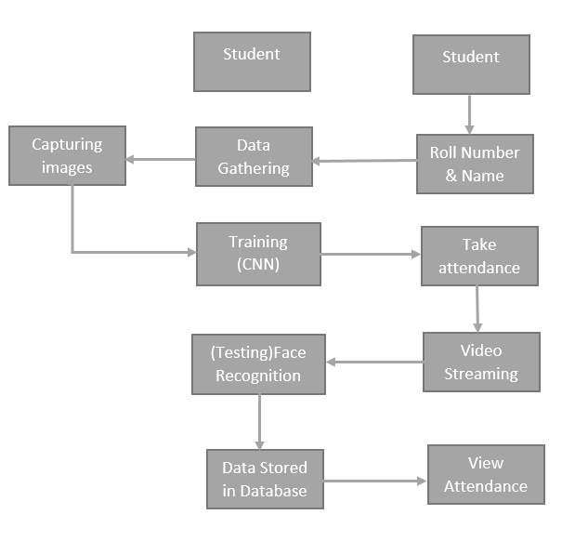
PROPOSED METHOD FLOW

Slide 14
ADVANTAGES OF PROPOSED METHOD
• Accurate option
• Increased productivity
• Easy and safe to use
• Convenient option

Slide 15
HARDWARE & SOFTWARE REQUIREMENTS:
H/W Configuration:
• Processor - I3/Intel Processor
• Hard Disk -160GB
• RAM - 8Gb
S/W Configuration:
• Operating System : Windows 7/8/10 .
• IDE : Pycharm.
• Libraries Used : Numpy, IO, OS, Html.
• Technology : Python 3.6+

Slide 16
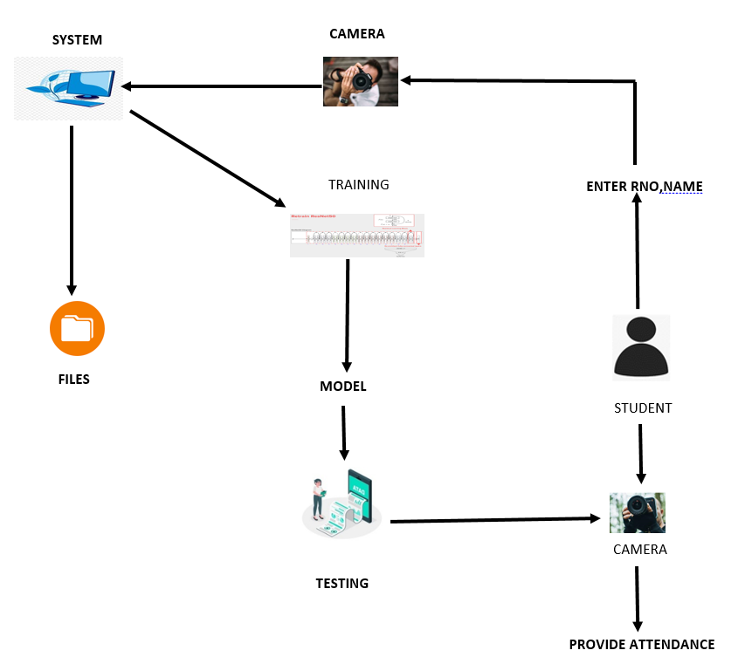
ARCHITECTURE:

Slide 17
PROBLEM STATEMENT
In manual attendance recording is not accurate because no one can taken properly, this causes the fake attendance and time consuming.
To overcome the above problem we introduce the biometric based attendance to reducing the time and face count.

Slide 18
IMPLEMENTATION
SYSTEM
Data Gathering:
After clicking the capture button the web cam will be opened for taking images and it captures 200 frames, after completion of taking images web cam will be automatically closed.
Training:
All captured images are stored into a Trainingimage folder. For training we use LBPHFaceRecognizer_create() method which is used for recognising the face features and we use CNN algorithm for classifying the faces. After training with CNN the model will be saved in to directory.

Slide 19
IMPLEMENTATION
Testing and considering the attendance
Whenever a student made a click on the button provided, a web cam will gets opened.
The web cam has ability to capture the image of the particular students face and then the image is converted into greyscale and it undergoes for scaling
The scaled image is converted into the form of vectors with the help of LBPHFaceRecognizer_create
Now the converted data will be helpful to predict the outcomes.

Slide 20
IMPLEMENTATION
There are 4 conditions to collect the attendance
1: Before 10AM – Early come 2. After 10AM – Late
3.Before 4PM – Early out 4. After 4PM- Normal out
After checking the conditions data will be stored into MySQL database.

Slide 21
IMPLEMENTATION
STUDENT
Enter Data:
After student adding the details like Roll number and Name.
After entering the details student click on the image capture button.
Take Attendance
Here student can select the options like take attendance button then only system can access the attendance. After that system stores the information into MYSQL database.
View Attendance
After entering the roll number student can view their attendance details of overall present hours in the college.

Slide 22
USE CASE DIAGRAM
A use case diagram in the Unified Modeling Language (UML) is a type of behavioral diagram defined by and created from a Use-case analysis. Its purpose is to present a graphical overview of the functionality provided by a system in terms of actors, their goals (represented as use cases), and any dependencies between those use cases. The main purpose of a use case diagram is to show what system functions are performed for which actor. Roles of the actors in the system can be depicted.

Slide 23
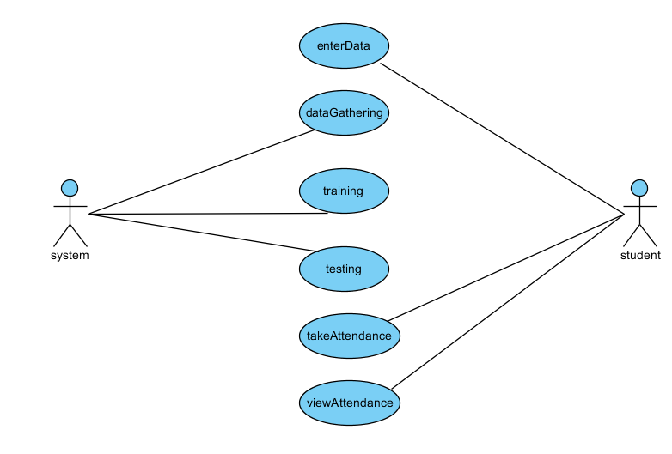
Use Case Diagram

Slide 24
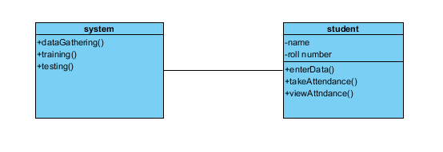
CLASS DIAGRAM
In software engineering, a class diagram in the Unified Modeling Language (UML) is a type of static structure diagram that describes the structure of a system by showing the system's classes, their attributes, operations (or methods), and the relationships among the classes. It explains which class contains information.

Slide 25
SEQUENCE DIAGRAM
A sequence diagram in Unified Modeling Language (UML) is a kind of interaction diagram that shows how processes operate with one another and in what order. It is a construct of a Message Sequence Chart. Sequence diagrams are sometimes called event diagrams, event scenarios, and timing diagrams.

Slide 26
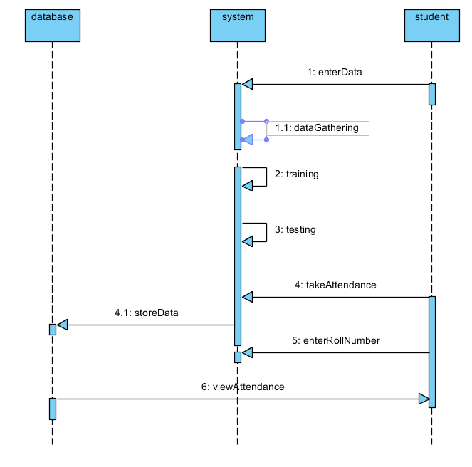

Slide 27
COLLABORATION DIAGRAM
In collaboration diagram the method call sequence is indicated by some numbering technique as shown below. The number indicates how the methods are called one after another. We have taken the same order management system to describe the collaboration diagram. The method calls are similar to that of a sequence diagram. But the difference is that the sequence diagram does not describe the object organization where as the collaboration diagram shows the object organization.

Slide 28
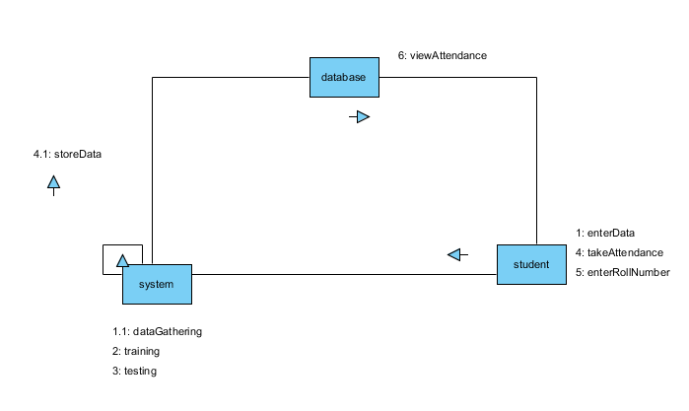

Slide 29
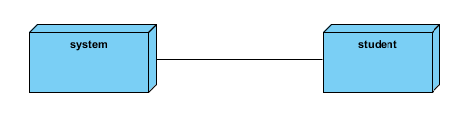
DEPLOYMENT DIAGRAM
Deployment diagram represents the deployment view of a system. It is related to the component diagram. Because the components are deployed using the deployment diagrams. A deployment diagram consists of nodes. Nodes are nothing but physical hardware used to deploy the application.

Slide 30
ACTIVITY DIAGRAM
Activity diagrams are graphical representations of workflows of stepwise activities and actions with support for choice, iteration and concurrency.
In the Unified Modeling Language, activity diagrams can be used to describe the business and operational step-by-step workflows of components in a system.
An activity diagram shows the overall flow of control.

Slide 31
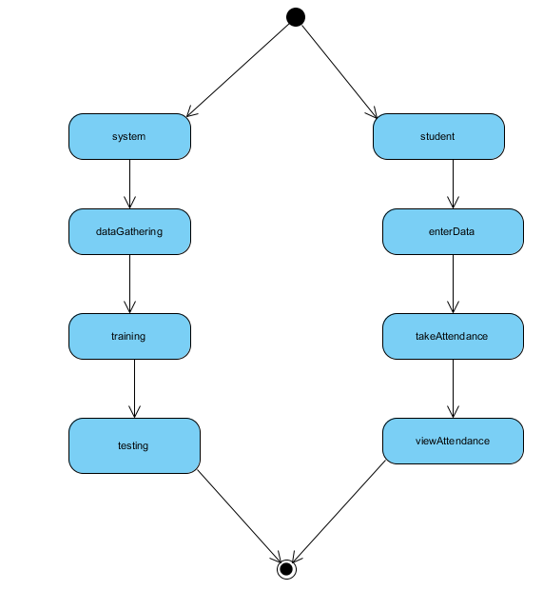

Slide 32
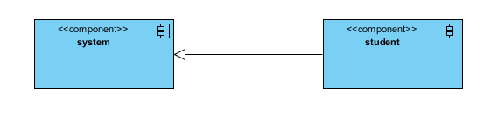
COMPONENT DIAGRAM
A component diagram, also known as a UML component diagram, describes the organization and wiring of the physical components in a system. Component diagrams are often drawn to help model implementation details and double-check that every aspect of the system's required functions is covered by planned development.

Slide 33
ENTITY RELATIONSHIP DIAGRAM
An Entity–relationship model (ER model) describes the structure of a database with the help of a diagram, which is known as Entity Relationship Diagram (ER Diagram). An ER model is a design or blueprint of a database that can later be implemented as a database. The main components of E-R model are: entity set and relationship set.
An ER diagram shows the relationship among entity sets. An entity set is a group of similar entities and these entities can have attributes. In terms of DBMS, an entity is a table or attribute of a table in database, so by showing relationship among tables and their attributes, ER diagram shows the complete logical structure of a database. Let’s have a look at a simple ER diagram to understand this concept.

Slide 34
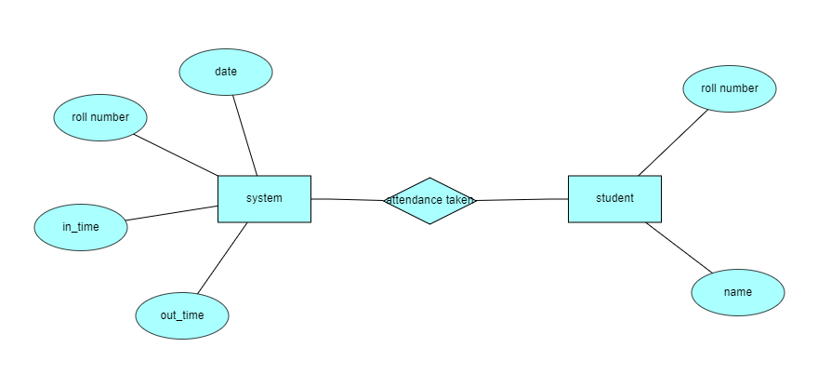

Slide 35
DATA FLOW DIAGRAM
A Data Flow Diagram (DFD) is a traditional way to visualize the information flows within a system. A neat and clear DFD can depict a good amount of the system requirements graphically. It can be manual, automated, or a combination of both. It shows how information enters and leaves the system, what changes the information and where information is stored. The purpose of a DFD is to show the scope and boundaries of a system as a whole. It may be used as a communications tool between a systems analyst and any person who plays a part in the system that acts as the starting point for redesigning a system.

Slide 36
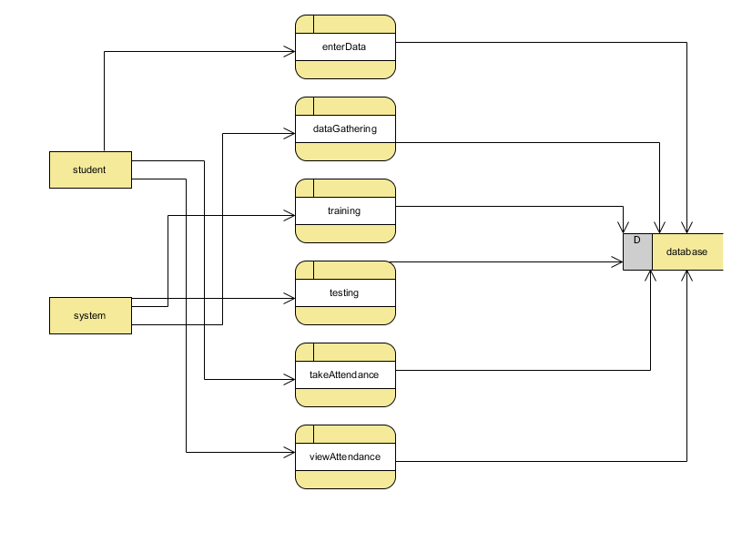

Slide 37
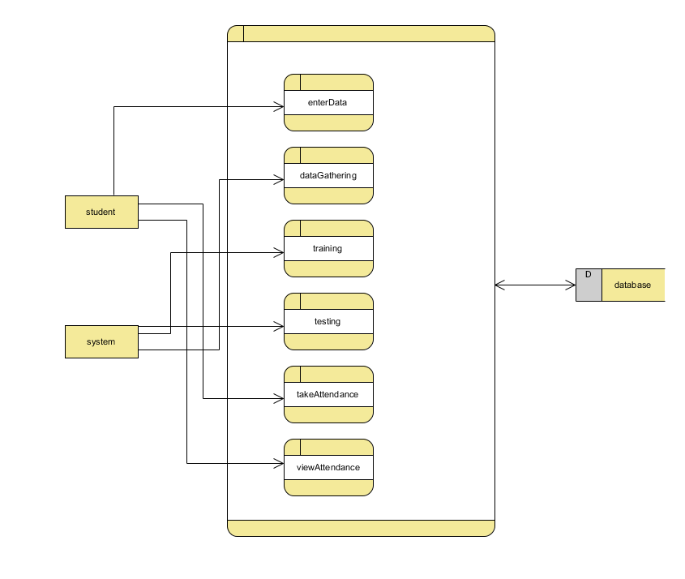

Slide 38
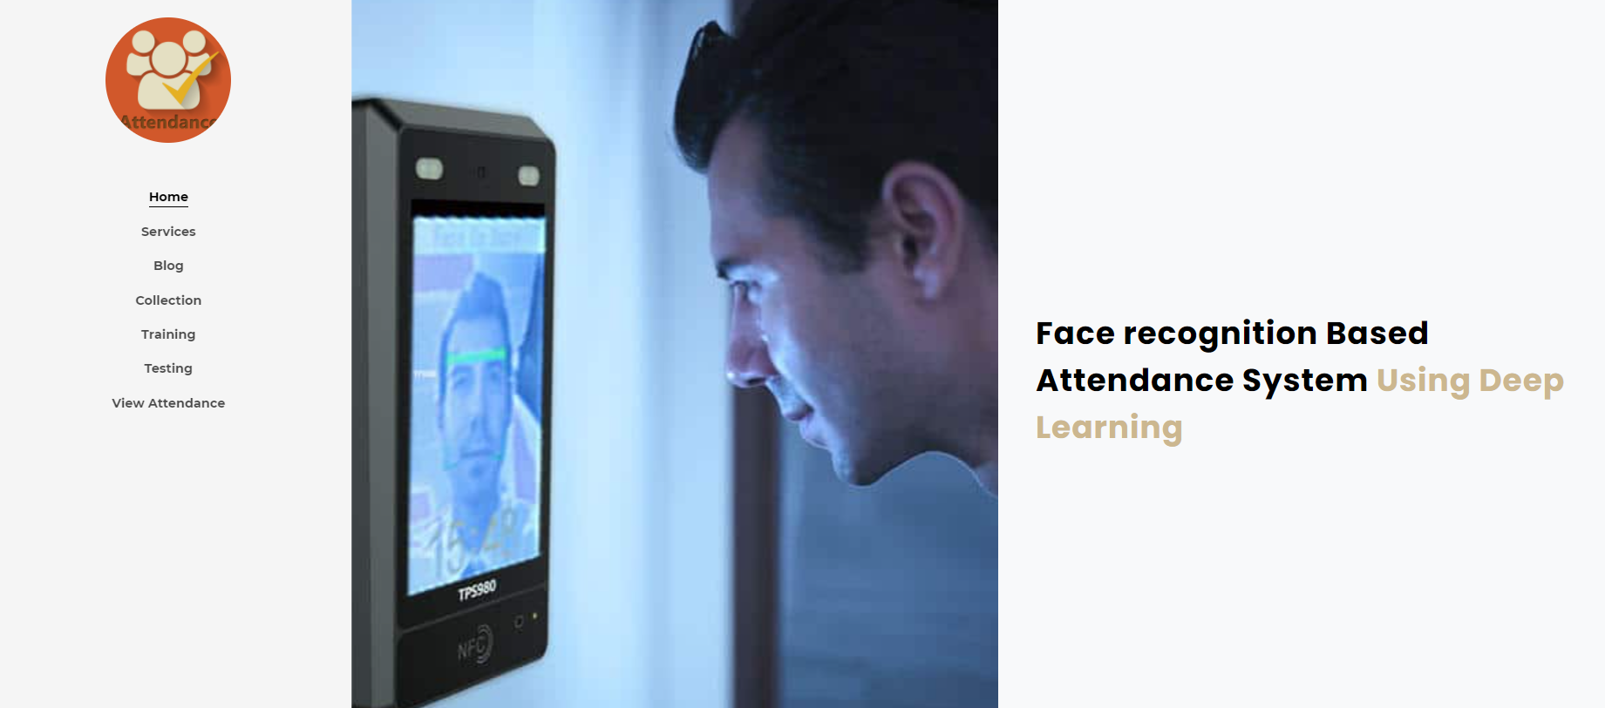
RESULTS
Home page:In this page will display the modules of a project

Slide 39

RESULTS
Blog page: Here display the main theme of project.

Slide 40

RESULTS
Services page:

Slide 41
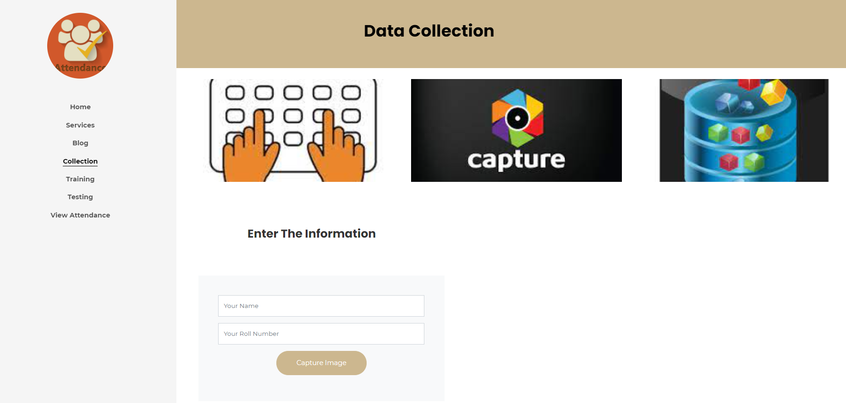
RESULTS
Upload data page:

Slide 42
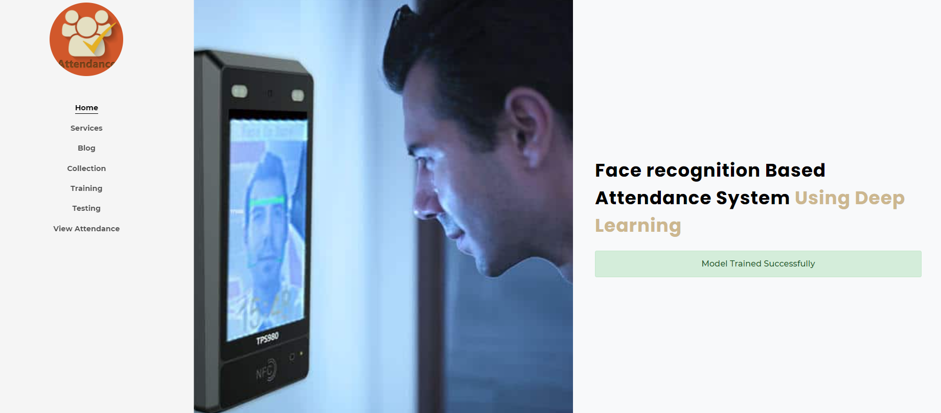
RESULTS
Data training page:

Slide 43
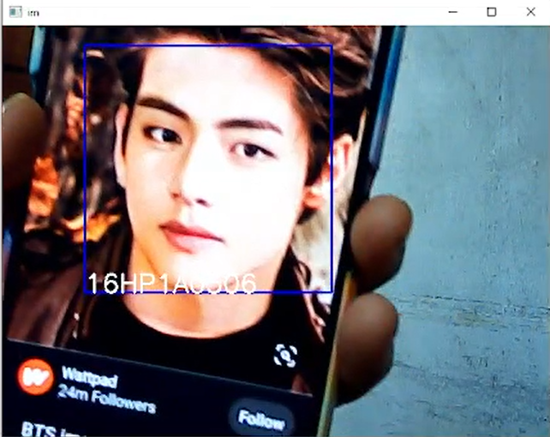
RESULTS
Take attendance page:

Slide 44
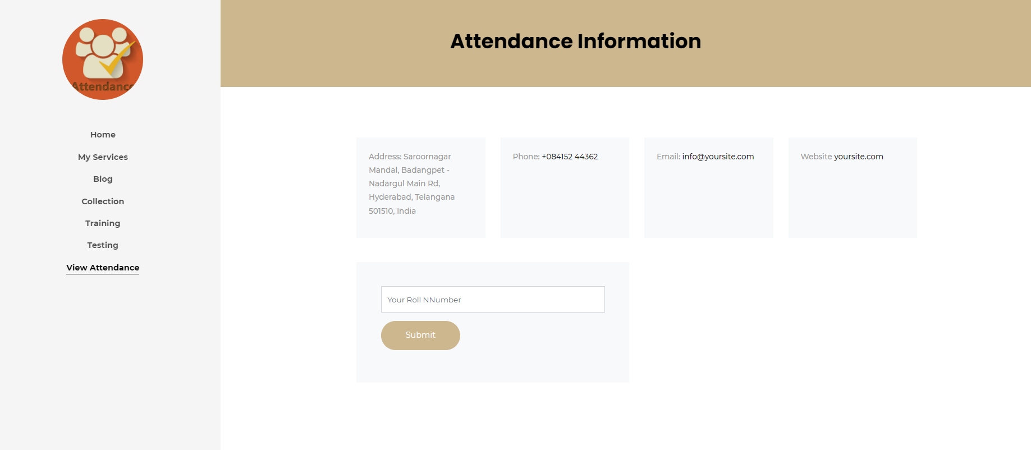
RESULTS
View Attendance page:

Slide 45
CONCLUSION
In our proposed work, we have created a model that which can take the attendance of student in the allotted times by the face recognition if student not recognized I the allotted attendance taken time they will be given attendance as late coming. We have used Flask Framework, where the information about the student are stored and a model is trained and then the student picture is captured which is tested and attendance is taken to the student by the captured face image.

Slide 46
REFERENCES
[1] Naveed Khan Balcoh, M. HaroonYousaf, Waqar Ahma and M. Iram Baig, Algorithm for efficient Attendance Management: Face Recognition Based approach, International Journal of Computer Science Issue, Vol.9, Issue 4, No 1, July 2012.
[2] NirmalayaKar, MrinalKanti Debbarma, Ashim Saha, and Dwijen RudraPal, Study of implementing Automated Attendance System using Implementing Automated Attendance System Using face recognition Technique, International Journal of Computer and Communication Engineering, Vol 1, No 2,July 2012
[3] O. Shoewn, Development of Attendance Management System using Biometrics. The Pacific Journal of Science and Technology Volume 13, No 1, May 2012
[4] M. Turk and A. Pentland (1991) “Face recognition using Eigen faces”. Proc.IEEE conference on computer vision and Pattern Recognition
[5] W.Zhao, R. Chellapa, P.J.Phillips and A.Rosenfld, “Face Recognition: A Literature Survey, vol. 35, No 4, Dec 2003, pp.399-458

